Slide 1
Lecture 9
Chapter-03
Discrete-Event System Simulation
-Jerry Banks
Discrete Events Simulation

Slide 2




Manual Simulation Using Event Scheduling
Example 3.5 (The Dump Truck Problem, Figure 3.7)
Traveling
Loading
Scale
Loader
Weighing
queue
queue
First-Come First-Served
First-Come First-Served
  The distributions of loading time, weighing time, and travel time are given in Tables 3.3, 3.4, and 3.5, respectively, from Table A.1.
  The purpose of the simulation is to estimate the loader and scale utilizations (percentage of time busy).

Slide 3
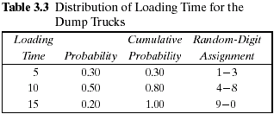
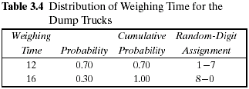
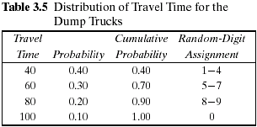

Manual Simulation Using Event Scheduling
  The activity times are taken from the following list as needed:

Slide 4
Manual Simulation Using Event Scheduling
  System state [LQ(t), L(t), WQ(t), W(t)]
    LQ(t) = number of trucks in loader queue
    L(t) = number of trucks (0, 1, or 2) being loaded
    WQ(t) = number of trucks in weigh queue
    W(t) = number of trucks (0 or 1) being weighed, all at simulation
    time t
  Event notices :
    (ALQ, t, DTi ), dump truck i arrives at loader queue (ALQ) at time t
    (EL, t, DTi), dump truck i ends loading (EL) at time t
    (EW, t, DTi), dump truck i ends weighing (EW) at time t
  Entities : The six dump trucks (DT 1, … , DT 6)
  Activities : Loading time, weighing time, and travel time

Slide 5
Manual Simulation Using Event Scheduling
  Simulation Starting Condition:
  Simulation will start depending on any of the two conditions.
  You need to use all the recourses from the beginning of the simulation.
  It has been assumed that five of the trucks are at the loaders and one is at the scale at time 0.

Slide 6
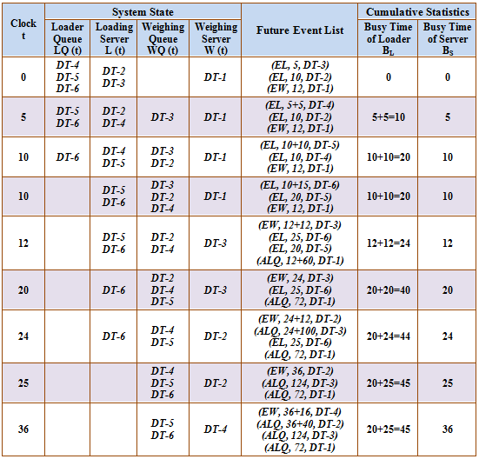

Slide 7
Manual Simulation Using Event Scheduling
  Simulation Ending Condition:
  Simulation will ends depending on any of the two conditions.
  After a specific time elapsed (will be mentioned in the problem). Or
  When all the truck go for travel.

Slide 8
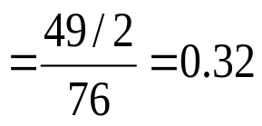
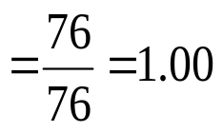
Manual Simulation Using Event Scheduling
  The utilizations are estimated as follows:
    average loader utilization
    average scale utilization

